Slide 1
final Website presentation on “kalyan jewellers” by:TEAM05NOV16 jc440134 jc424959

Slide 2
Pages:
Home
Brand
Contact us
Collection
Login
Logout
Kalyan stories
registration

Slide 3
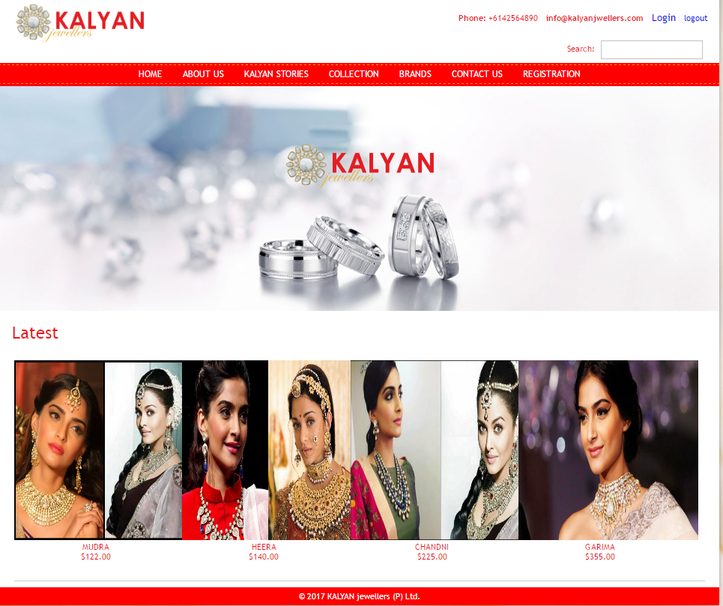
Home page:

Slide 4
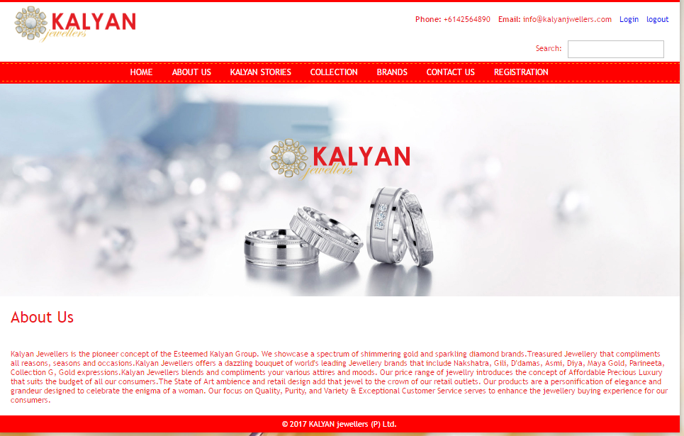
About us:

Slide 5
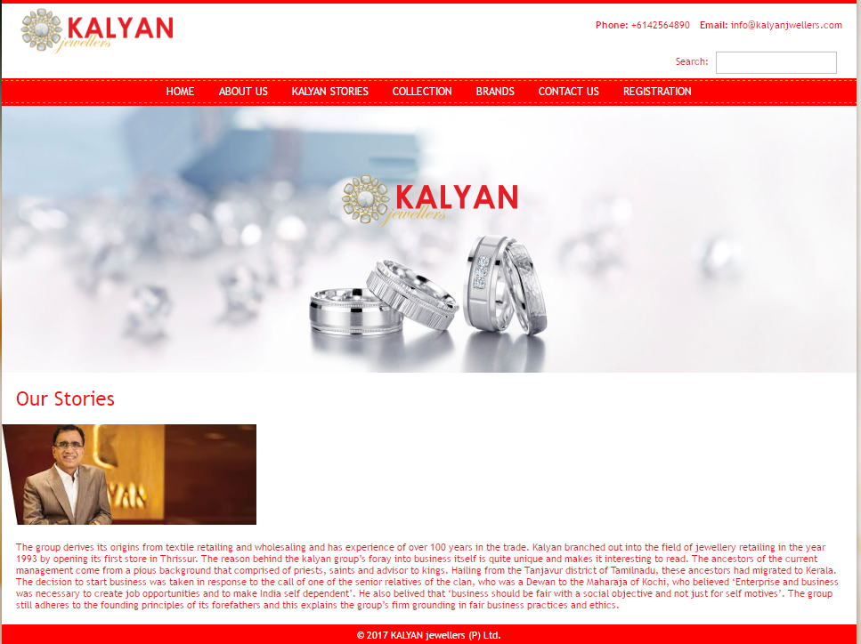
Kalyan stories

Slide 6
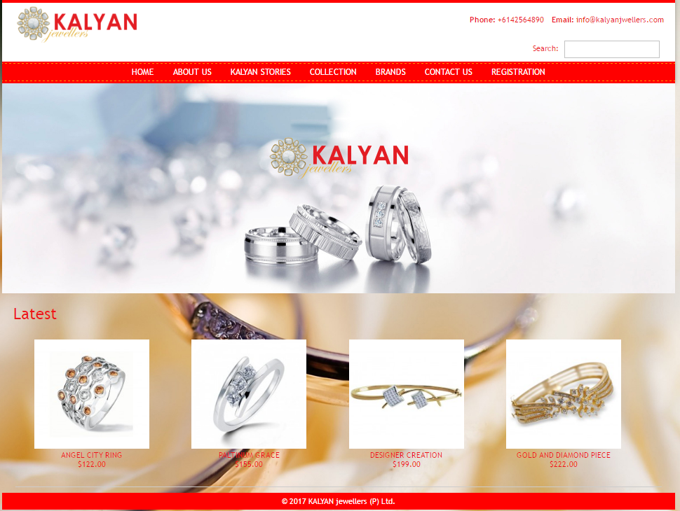
collection

Slide 7
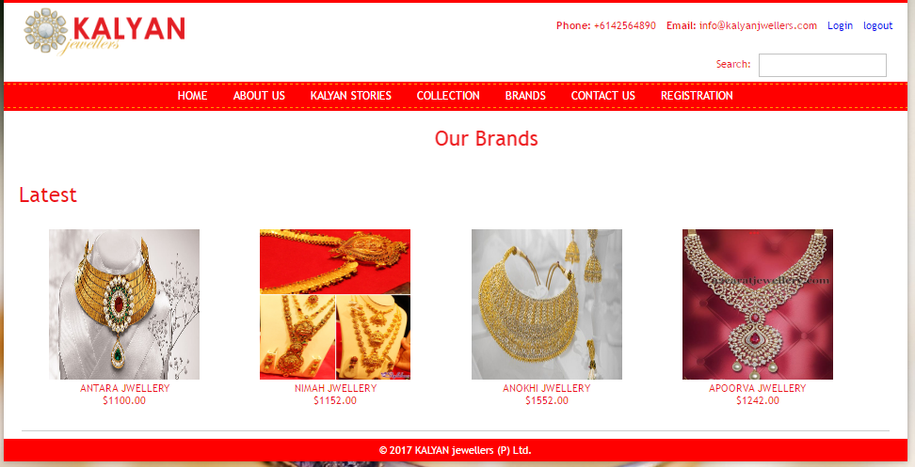
brands

Slide 8
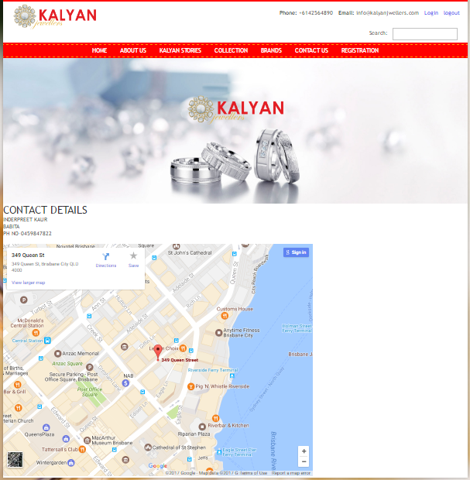
CONTACT US

Slide 9
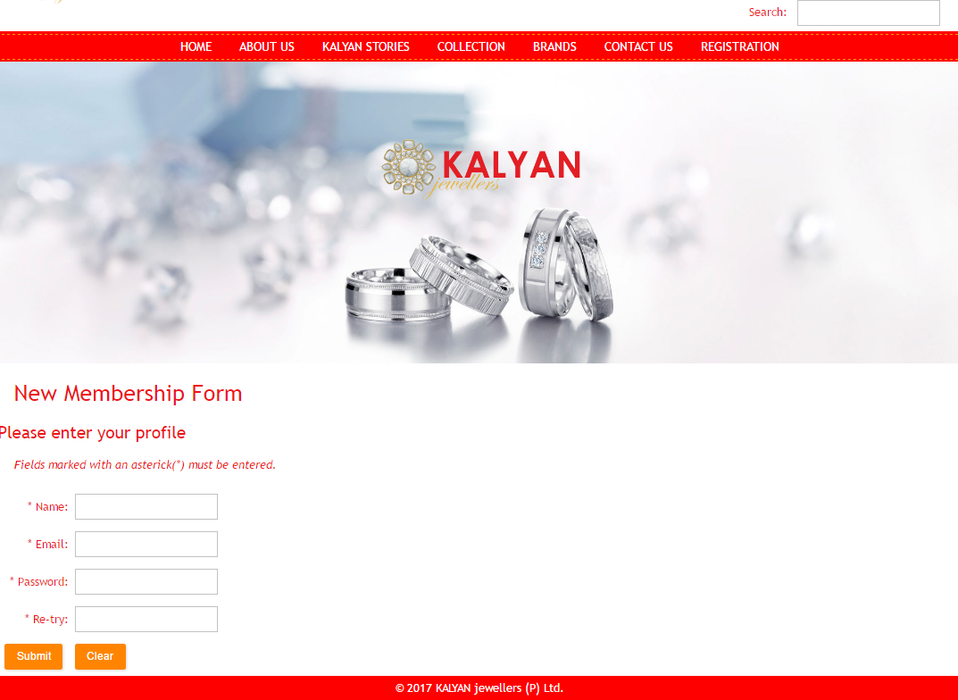
REGISTRATION

